Slide 1
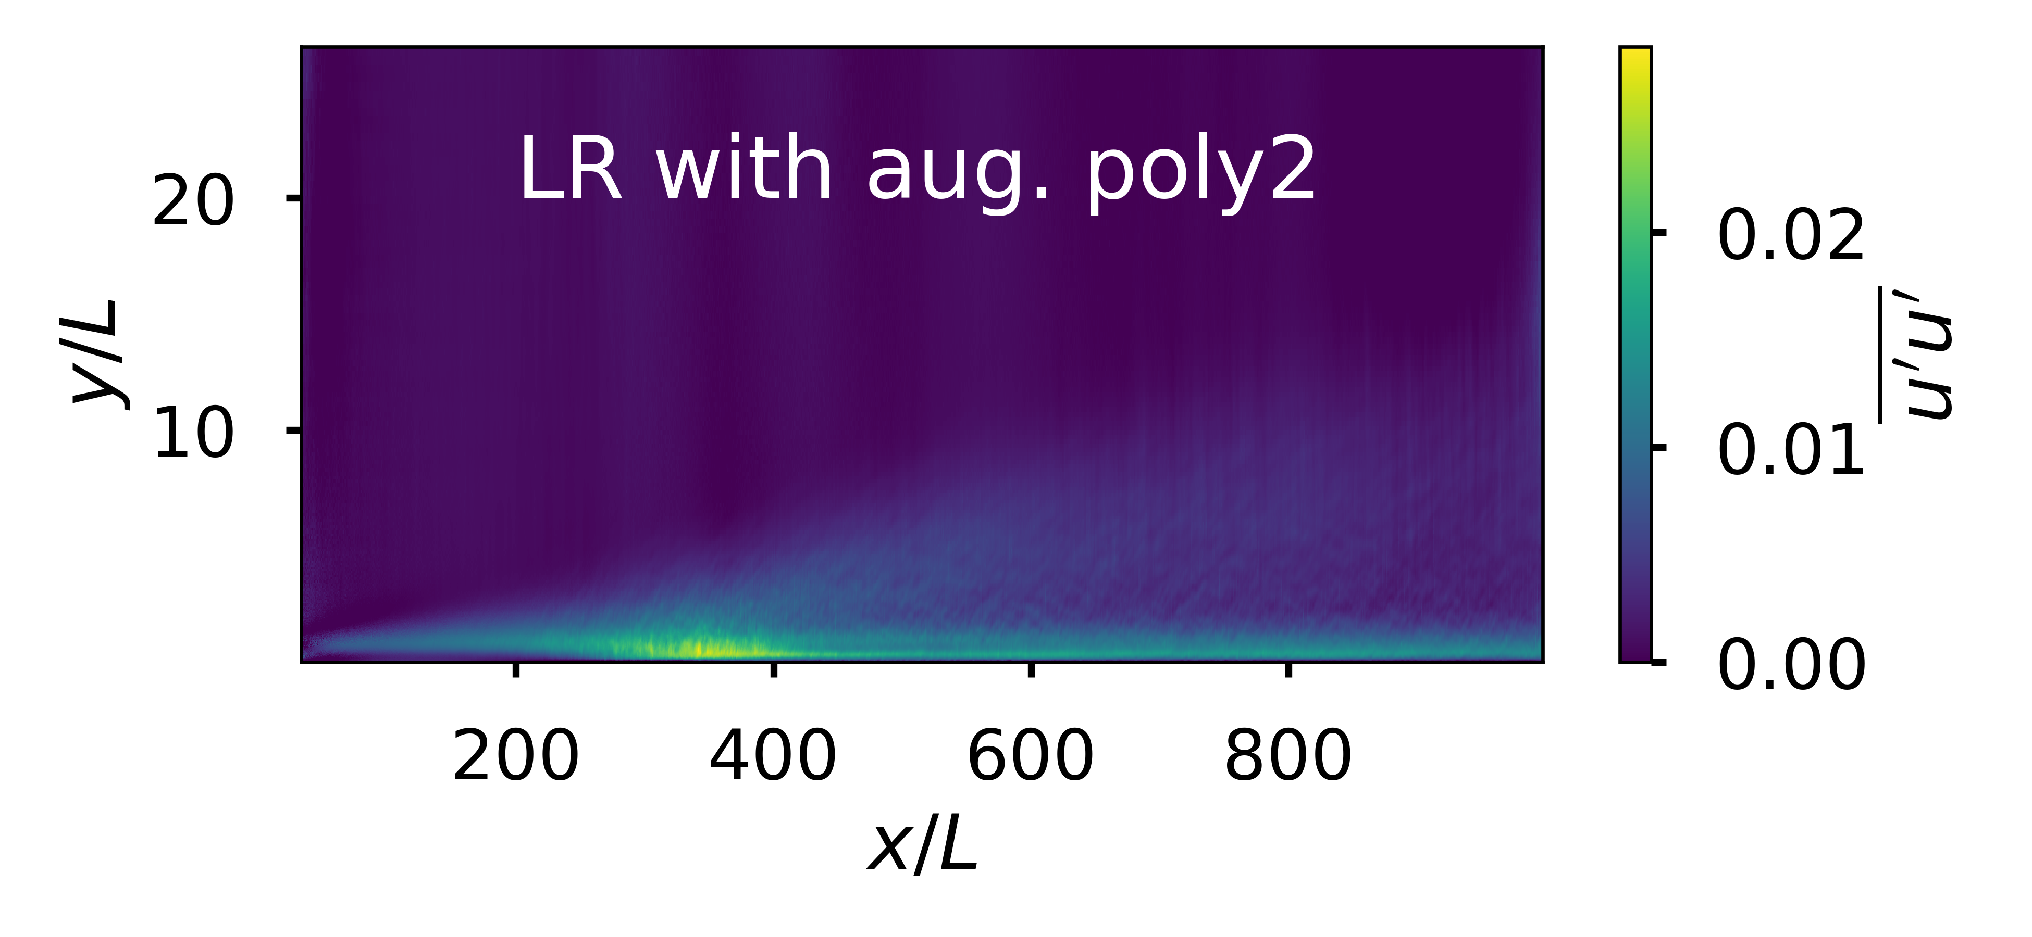
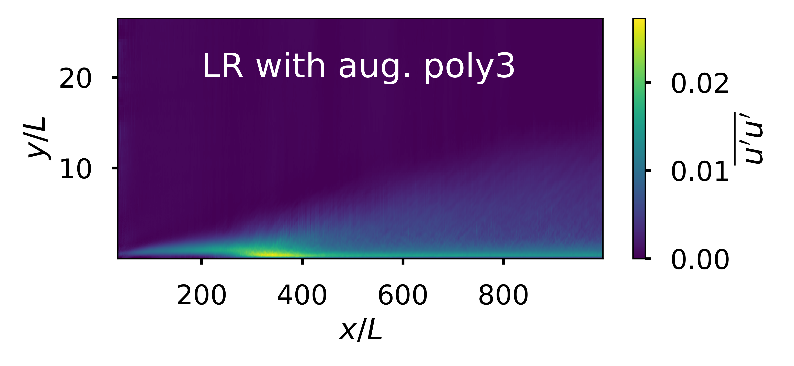
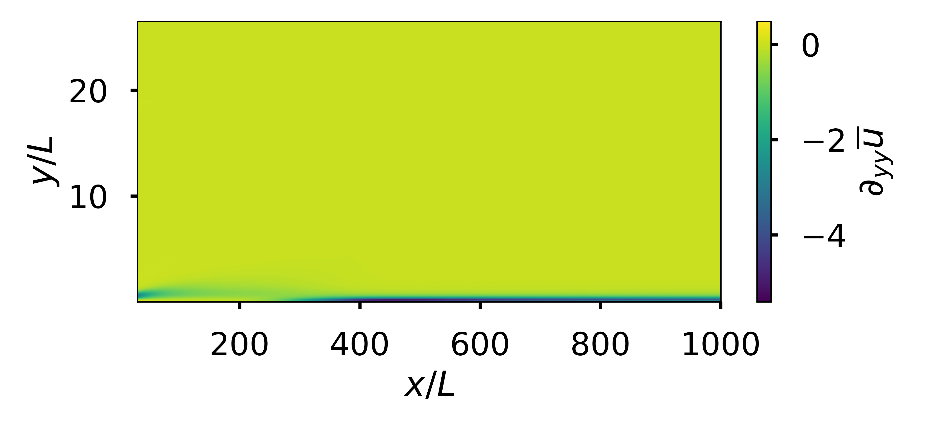
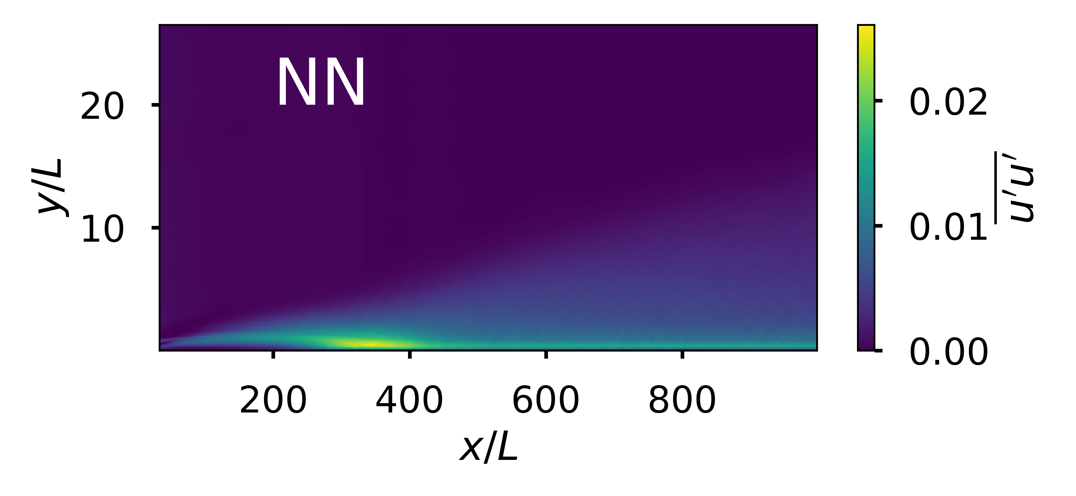
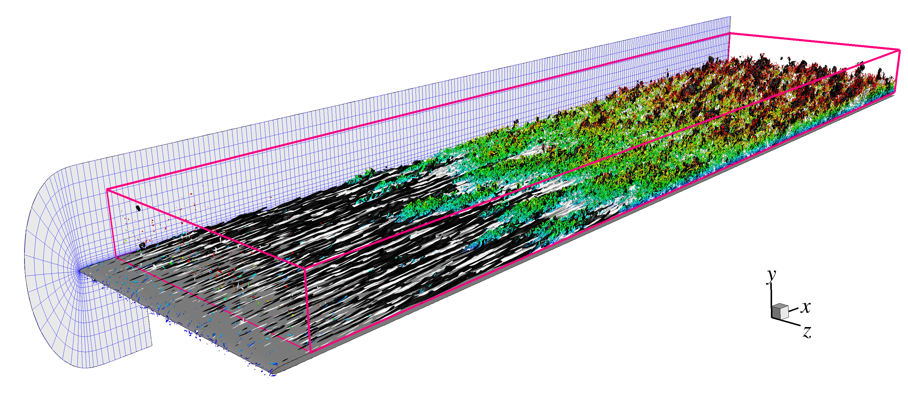
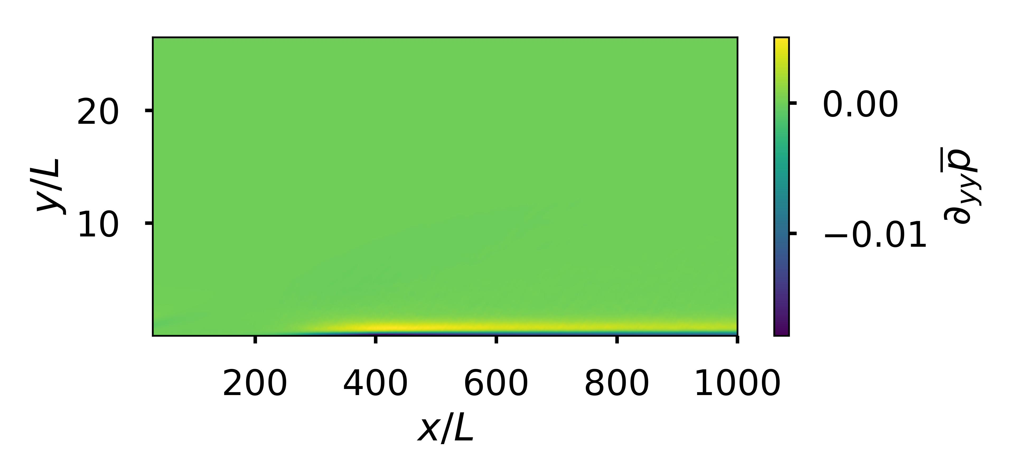
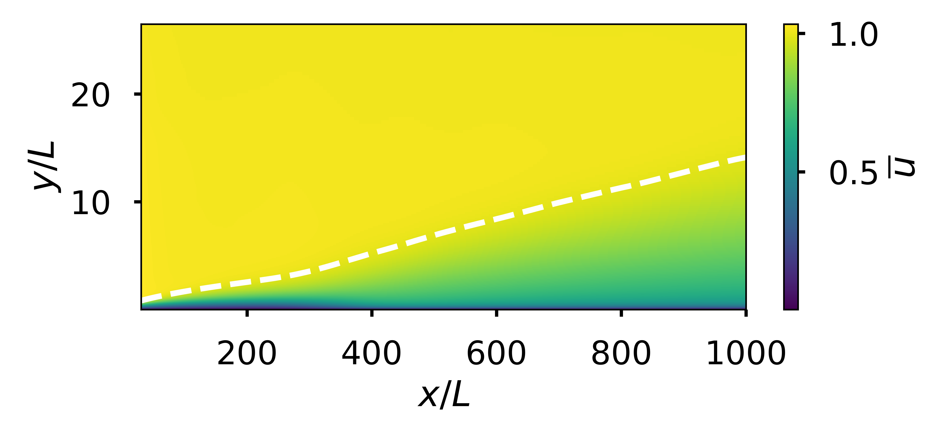
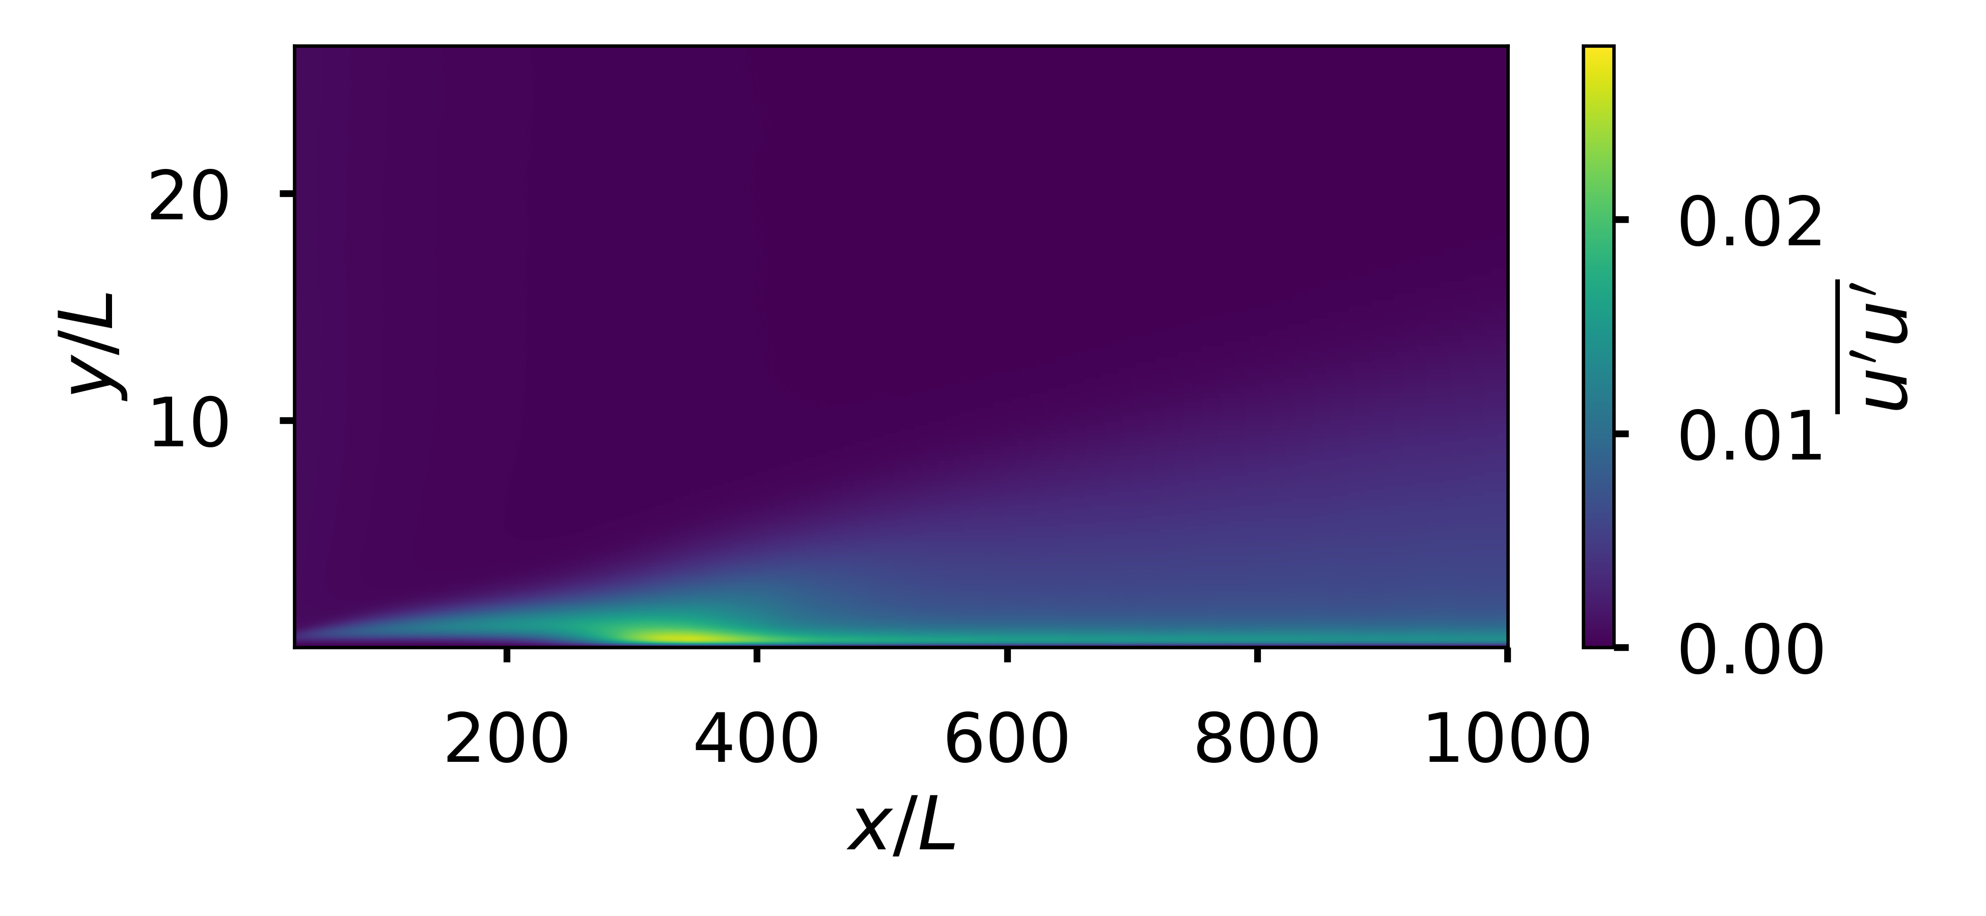


ML, boundary layer transition, and Reynolds stresses
Shaun Harris (srharris@stanford.edu)
Mechanical Engineering
CS229: Project
Motivation and Data
Features
Models
Results and Discussion
Computation fluid dynamics (CFD) relies on computing the nonlinear perturbation terms that arise in the Navier-Stokes equations.
I explore various techniques to model these terms using ML given the average base flow gradients and compare the models for a transitional boundary layer.
Data obtained from the JHTDB at http://turbulence.pha.jhu.edu
To keep the input features Galilean invariant and have physical meaning, the input features selected included averaged velocity gradients, pressure, pressure gradients and kinematic viscosity:
The output features included the nonlinear averaged perturbation terms:
The models tested here include linear regression (LR) and a simple neural network (NN) (two 100 neuron layers with ReLU activation).
Data augmentation included adding random values to the input features on the order of 2% and by generating polynomial and interaction features of degree 2 and 3.
Four models tested and shown here:
LR without aug.
LR with aug. poly2
LR with aug. poly3
NN without aug.
R² score was used to compare the resulting models.
Linear regression with polynomial feature expansion of degree 3 yielded the best fit on a 70/30 data split validation.
A simple neural network followed closely behind.
Permutation Importance or Mean Decrease Accuracy on LR showed the most important input features to be for poly2:
and for poly3:
White and black:
Color:
Streamwise average base flow
R² | Training | Test
1) LR | 0.728279 | 0.729059
2) LR poly2 | 0.951162 | 0.952244
3) LR poly3 | 0.992689 | 0.993555
4) NN | 0.990437 | 0.990409
ELI5

